Slide 1
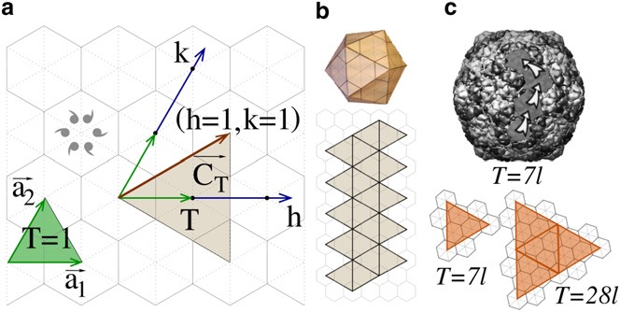
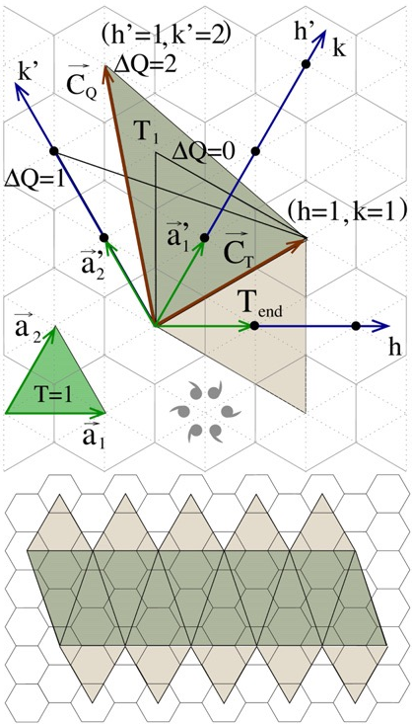
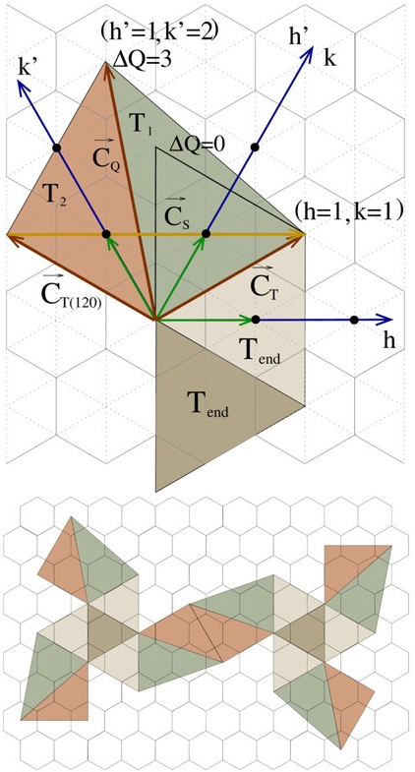
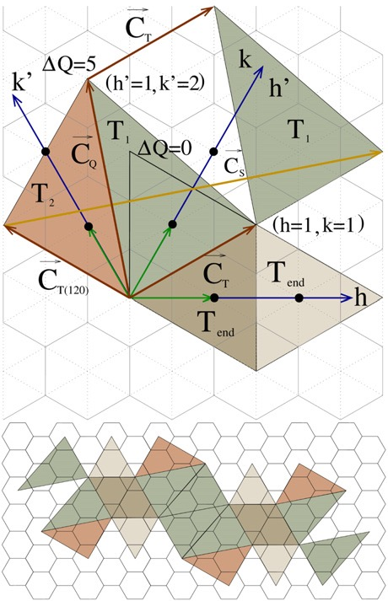
Elongated Capsid Generation in the Browser
Daniel Antonio Negrón, PhD-c; George Mason University, School of Systems Biology
[ Introduction ]
[ Methods ]
[ Results ]
Previous work implemented the Caspar-Klug capsid model in the browser. This work adds functionality based on the Moody construction and results from Luque and Reguera (2010) to accommodate additional viral phenotypes. The result is a parameterized application built on paper.js that generates elongated capsid nets as high-quality SVG images. Next steps include the generation of three-dimensional models with alternate tiling models.
Repository: https://github.com/dnanto/capsid
Prototype: https://dnanto.github.io/capsid/net.html
Reference
Application Screenshot
(Luque & Reguera, 2010)
Caspar-Klug
Fivefold Symmetry
[ Acknowledgements ]
Dissertation committee:
Dr. Donald Seto (chair)
Dr. Patrick Gillevet
Dr. Sterling Thomas
Threefold Symmetry
[ References ]
Caspar, D. L., & Klug, A. (1962). Physical principles in the construction of regular viruses. Cold Spring Harbor Symposia on Quantitative Biology, 27, 1–24. https://doi.org/10.1101/sqb.1962.027.001.005
Moody, M. F. (1965). The shape of the T-even bacteriophage head. Virology, 26(4), 567–576. https://doi.org/10.1016/0042-6822(65)90319-3
Luque, A., & Reguera, D. (2010). The Structure of Elongated Viral Capsids. Biophysical Journal, 98(12), 2993–3003. https://doi.org/10.1016/j.bpj.2010.02.051
Lehni, J., & Puckey, J. (2020). Paperjs/paper.js [JavaScript]. Paper.js. https://github.com/paperjs/paper.js (Original work published 2011)
Twofold Symmetry

